Slide 1
AI Course Chatbot
A Local RAG Solution for Intelligent Document Q&A
Presenter: Lerner Samuel
Duration: 10 Minutes

Slide 2
Introduction & Project Vision(1 Min)
The Problem: Documents (PDFs) are often dense and difficult to navigate quickly. Traditional search only finds keywords, not concepts.
The Solution: A Retrieval-Augmented Generation (RAG) chatbot that allows users to "talk" to their documents.
Key Value Proposition:
  Privacy: Entirely local processing via Ollama.
  Accuracy: Context-aware responses with direct citations.
  Accessibility: Both Web UI and CLI interfaces.
Lerner Samuel

Slide 3
Core Technologies(1 Min)
LLM Engine: Ollama running gemma3:4b-it-qat for generation.
Embeddings: nomic-embed-text.
Vector Database: ChromaDB for persistent, on-disk storage.
Orchestration: LangChain for RAG logic and FastAPI for the web backend.
Background Tasks: Celery with SQLite for asynchronous document processing.
Lerner Samuel

Slide 4
System Architecture(2 Mins)
Layered Approach:
UI Layer: Modern SPA (HTML/JS) and CLI tools.
RAG Layer: Handles the "Query → Retrieval → Prompt → Answer" flow.
Vector Store Layer: Manages embeddings and similarity searches.
Processing Layer: PDF text extraction using PyPDF and text chunking.
Data Storage: Persistent storage in ./chroma_db.
Lerner Samuel

Slide 5
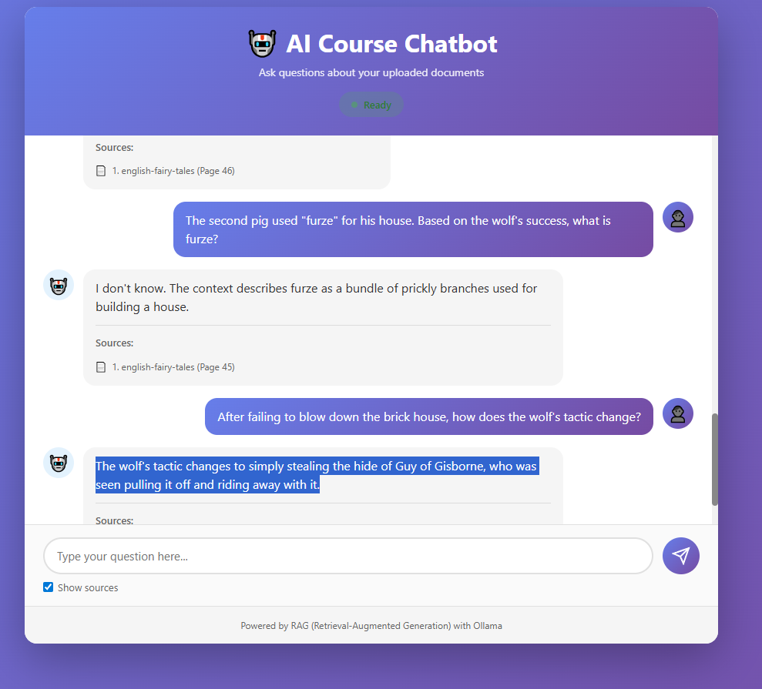

Slide 6
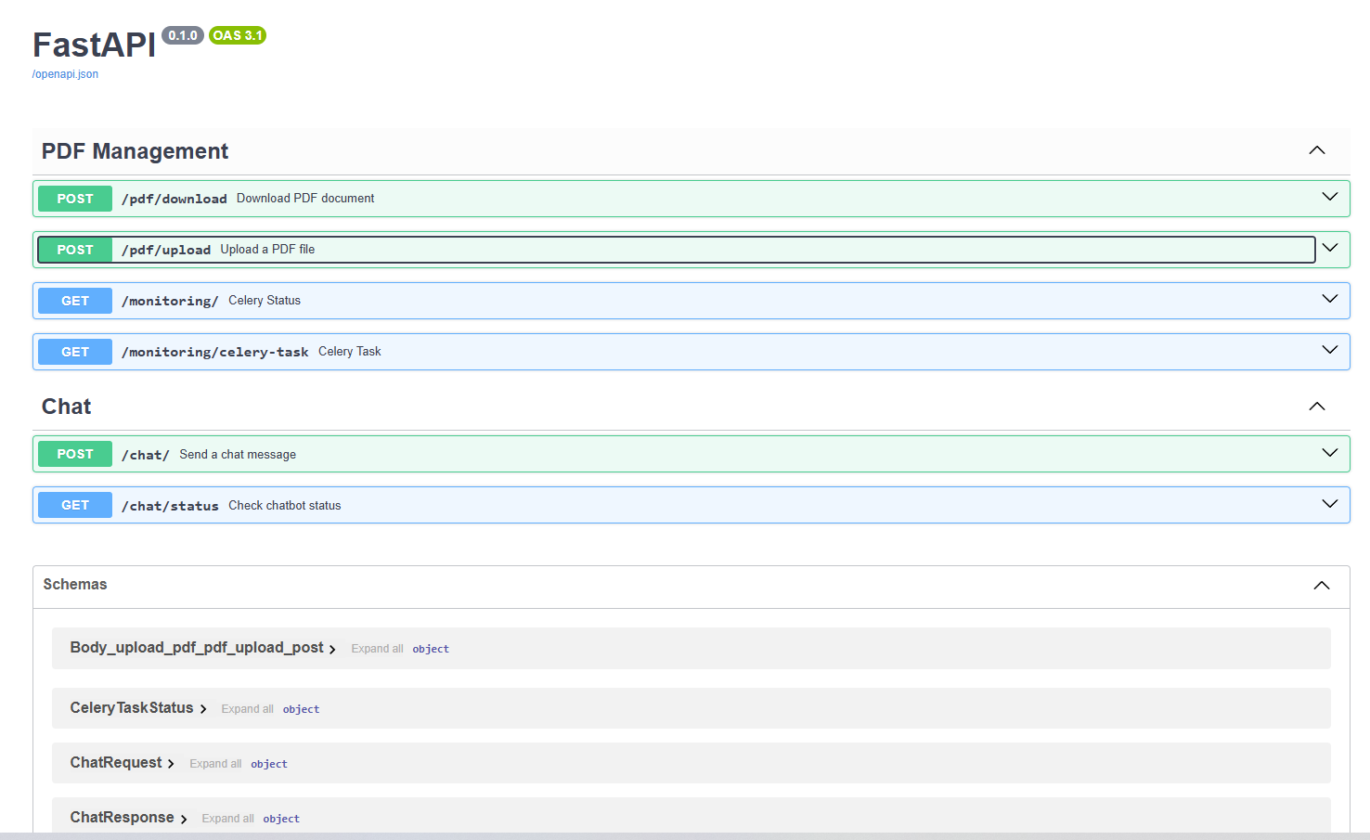

Slide 7
The Data Flow(1.5 Mins)
Ingestion Path:
PDFs are loaded → Split into 1,000-character chunks (200-character overlap).
Chunks are converted to vectors (Embeddings).
Stored in ChromaDB with deterministic IDs to prevent duplicates.
Retrieval Path:
User asks a question → Question is embedded.
System finds top k=4 most relevant document chunks.
LLM generates an answer based only on that context
Lerner Samuel

Slide 8
Key Features & Demo Highlights(1.5 Mins)
Deduplication: Uses SHA-256 hashes of text to ensure the same info isn't stored twice.
Source Citations: Every answer includes the filename and page number for transparency.
Flexible Ingestion: Supports local CLI uploads, web-based multipart uploads, and URL-based PDF downloads.
Asynchronous Processing: Large PDFs are processed in the background via Celery so the UI never freezes.
Lerner Samuel

Slide 9
Monitoring & Scalability(1min)
Task Monitoring: Dedicated /monitoring/ endpoints to track Celery task status (RUNNING, SUCCESS, FAILURE).
http://localhost:8000/monitoring/
Current Scale: Optimized for personal use or small teams (thousands of pages).
Future Growth: Could transition to cloud vector stores (Pinecone) or remote APIs for larger enterprise needs.
Lerner Samuel

Slide 10
Getting Started & Conclusion(1min)
Quick Setup:
  Pull models in Ollama.
  Install requirements.
  Run setup_vector_store.py to ingest PDFs.
  Launch FastAPI server.
Final Thought: This project demonstrates a robust, production-ready pattern for local AI tools that respect data privacy while delivering high utility.
Lerner Samuel

Slide 11
Thank you
https://github.com/lersam/ai-course-chatbot

